Slide 1
Build a Machine Learning System using IBM Cloud Private for Data Platform (ICP4D), Watson Studio Local (WSL) and Hadoop
Vish Kamat – vkamat@us.ibm.com IBM Data Science Expert Lab
Linda Liu – linda.liu@us.ibm.com IBM Data Science Expert Lab
Feb. 15, 2019

Slide 2
Agenda
The Challenge and the Solution
What is IBM Watson Studio Local (WSL)
What is IBM Cloud Private for Data (ICP4D)
ICP4D & Watson Studio Local Lifecycle Overview
ICP4D (or WSL) and Hadoop
QAs

Slide 3
Build a ML System using ICP4D (or WSL) and Hadoop
Challenge
You have a huge investment in Hadoop infrastructure but the tools in the ecosystem are not intuitive for business analyst and users. Most of your data is probably available within your HDFS along with your huge compute capacity but access to it is difficult.
Solution
Build machine learning and analytics on ICP4D platform or Watson Studio that provides variety of open source libraries and frameworks such as Spark, R, Keras, TensorFlow, Scikit-learn as a service within a kubernetes based platform behind your firewall. Along with cloud agility the platform provides end-end data management and analytics capability with collaboration and lifecycle management functions.
Hadoop connector provides seamless access to compute power available along with easy access to hdfs data.
Benefit
Accelerate your machine learning deployments in hours as oppose to months. Build quick to market business decision making Artificial Intelligence systems easily and quickly.

Slide 4
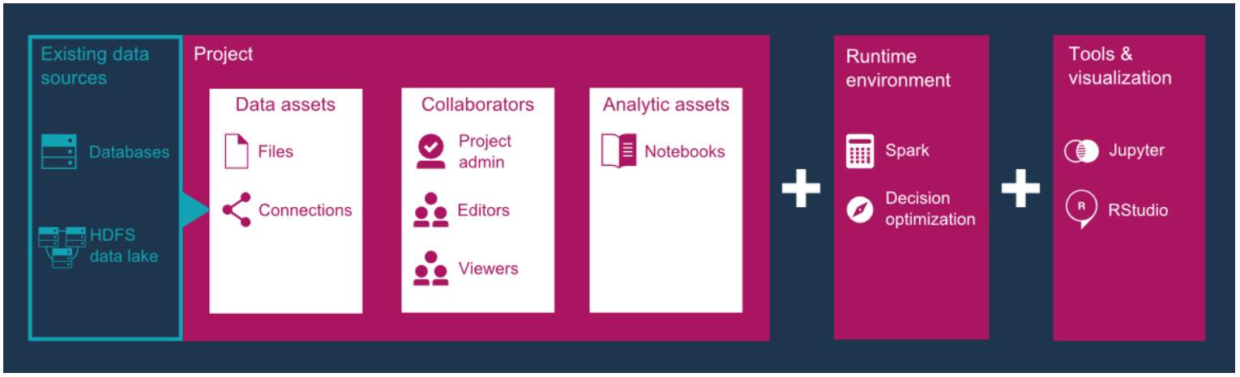
What is IBM Watson Studio Local (WSL)
IBM Watson Studio Local is an out-of-the-box enterprise solution for data scientists and data engineers.
It offers a suite of data science tools, such as RStudio, Spark, Jupyter, and Zeppelin notebooks, that are integrated with proprietary IBM technologies.

Slide 5
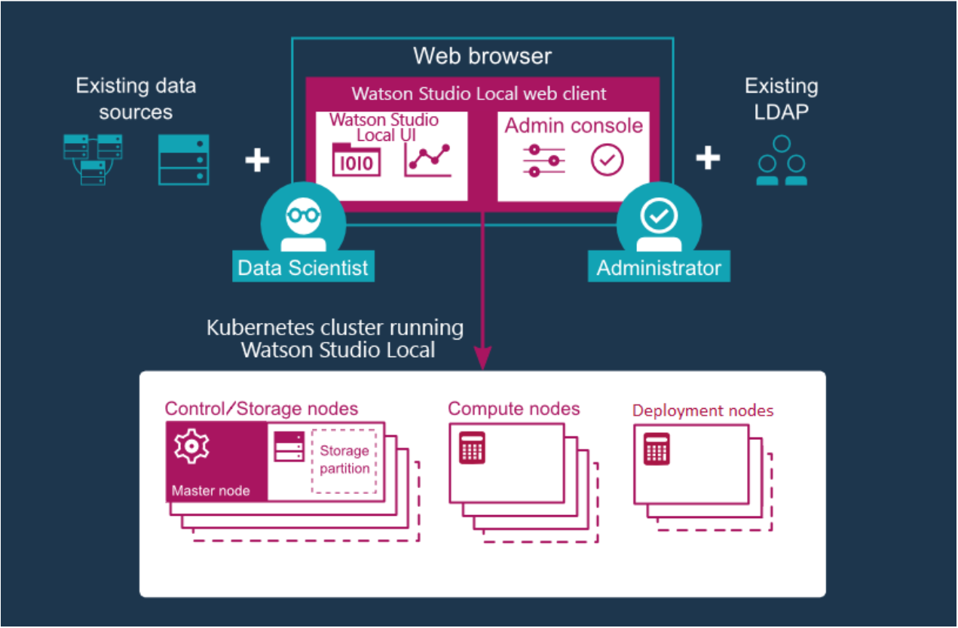
What is IBM Watson Studio Local (WSL)
Architecture

Slide 6
Why & What is IBM Cloud Private for Data (ICP4D)
ICP For Data Platform Functionalities

Slide 7
IBM Cloud Private for Data – End-to-end AI workflow
Collect, Connect & Access Data
Govern, Search and Find Data
Understand & Prepare Data for Analysis
Build and Train ML/DL Models
Deploy Models
Monitor, Analyze and Manage
Connect and discover content from multiple data sources in the cloud or on premises. Bring structured and unstructured data to one toolkit.
Find data (structured, unstructured) and AI assets (e.g., ML/DL models, notebooks, Watson Data Kits) in the Project Assets with intelligent search and giving the right access to the right users.
Clean and prepare your data with Data Stage or ETL Tooling. Use popular open source libraries to prepare unstructured data.
Democratize the creation of ML and DL models. Design your AI models programmatically or visually with the most popular open source and IBM ML/DL frameworks or leverage transfer learning on pre-trained models using analytics tools to adapt to your business domain. Train at scale on GPUs and distributed compute
Deploy your models easily and have them scale automatically for online, batch or streaming use cases
Monitor the performance of the models in production and trigger automatic retraining and redeployment of models. Build Enterprise Trust with Bias Detection, Mitigation Model Robustness and Testing Service Model Security.

Slide 8








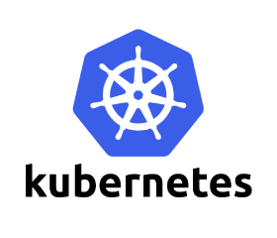

ICP For Data - Comprehensive set of tools for the end-to-end AI workflow
Create, collaborate, deploy, and monitor
Best of breed open source & IBM tools
Code (R, Python or Scala) and no-code/visual modeling tools
Most popular open source frameworks
IBM best-in-class frameworks
Container-based resource management
Fit for Purpose Deployment
Dynamic Resizing
Authoring Tools
Model Builder
Watson APIs & Tools
Data Assets
Machine Learning Runtimes
Deep Learning Runtimes
Cloud Infrastructure as a Service
Model Lifecycle Management

Slide 9






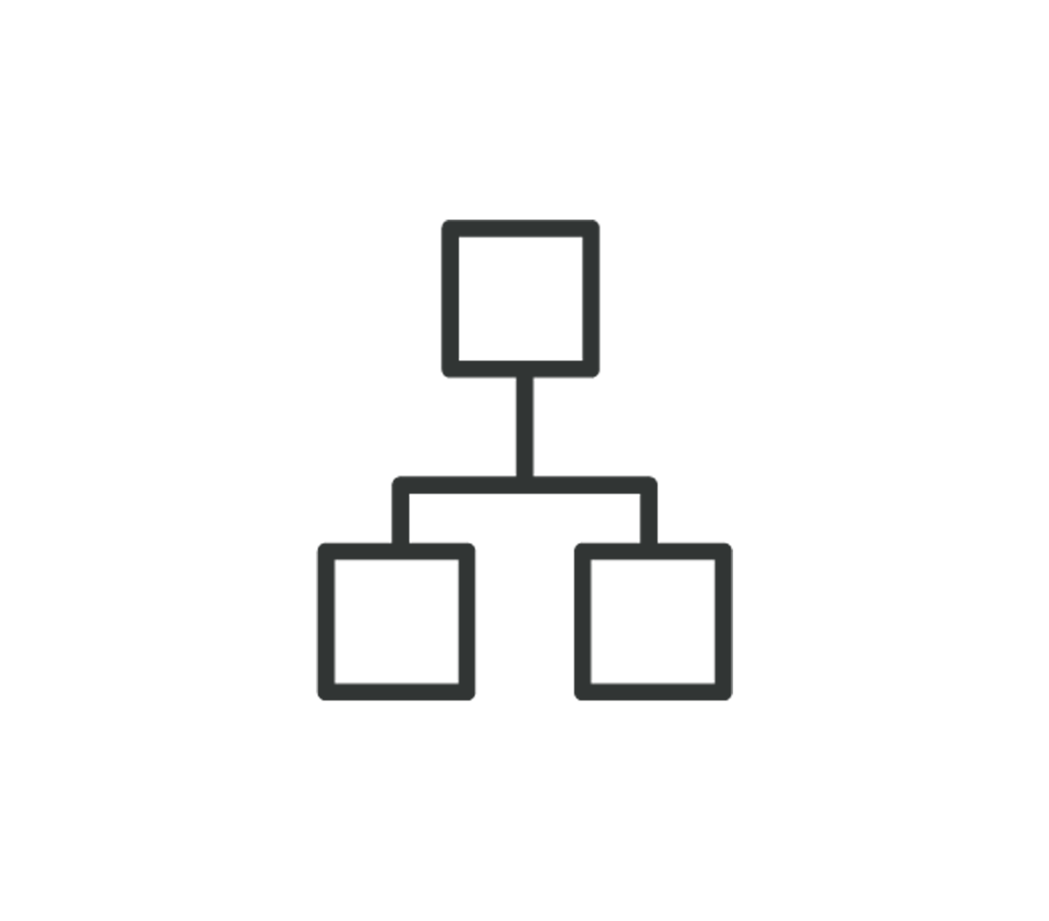


Why & What is IBM Cloud Private for Data (ICP4D) - continue
Extensible, Open API Platform
Personalized, Collaborative Team Platform
App Developers
Data Engineers
Business Partners
Data Scientists
Business Analysts & CxOs
Data Stewards
Cloud-native Scalable Data Micro Services
Collect
Organize
Analyze
Databases on-demand
Data warehousing
Fast Data Ingest
Federated query
Data integration
Data curation
Governance & policies
Data Asset lifecycle management
Data Science
Predictive Modeling & ML
Data Visualization & Exploration
Dashboards & reporting
Enterprise Data Catalog
Integrated Admin & Ops Dashboards, storage management, identity access management
IBM Cloud Private
Kubernetes

Slide 10
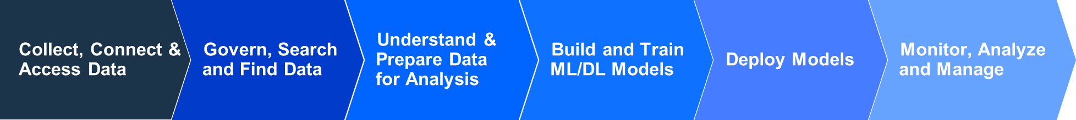
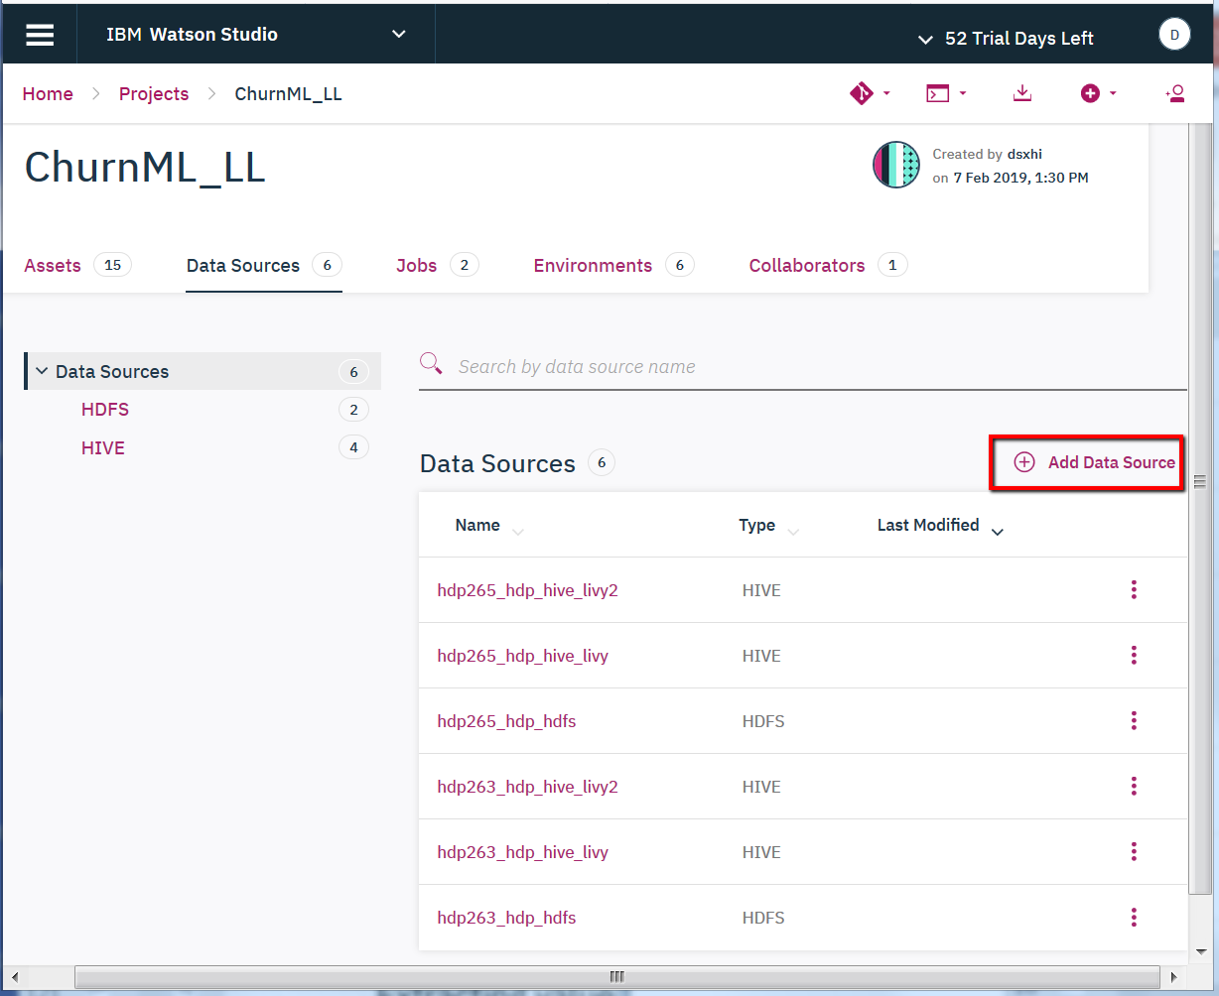
ICP4D/WSL – Lifecycle Overview
Create Data Sources, Load Data Sets
You can create data sources and remote data sets for the following databases and services
Big SQL
DB2 Warehouse on Cloud
DB2 for z/OS
Hive
HDFS
Hyperledger Composer
Informix
Microsoft SQL Server (MSSQL)
Netezza
Oracle

Slide 11
ICP4D/WSL – Lifecycle Overview
Cataloging and Governance Data
Create/Import a data dictionary
Creating terms and categories
Creating governance policies and rules
Governing analytical assets

Slide 12
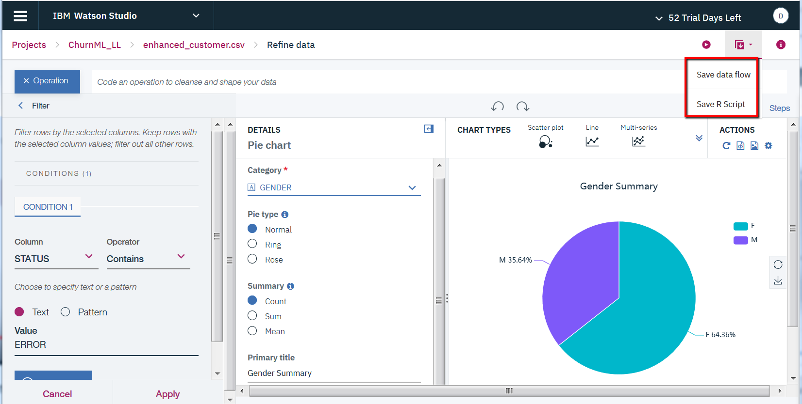
ICP4D/WSL – Lifecycle Overview
Refine Data Sets
Before you analyze local data sets, you can refine the data by cleansing and shaping it.
Use the Data Refiner to perform the following tasks:
Set up data
Create a data flow
Profile data
Visualize data
Run the flow as a job

Slide 13
ICP4D/WSL – Lifecycle Overview
Create Machine Learning Models
ICP4D/WSL Client provides tools to help you create and train machine learning models that can analyze data assets and extract value from them. Users can also deploy their models to make them available to a wider audience.
WSL supports the following machine learning model types:
Spark ML
PMML with online scoring
Custom models with batch scoring
scikit-learn
XGBoost
Keras
TensorFlow
WML

Slide 14
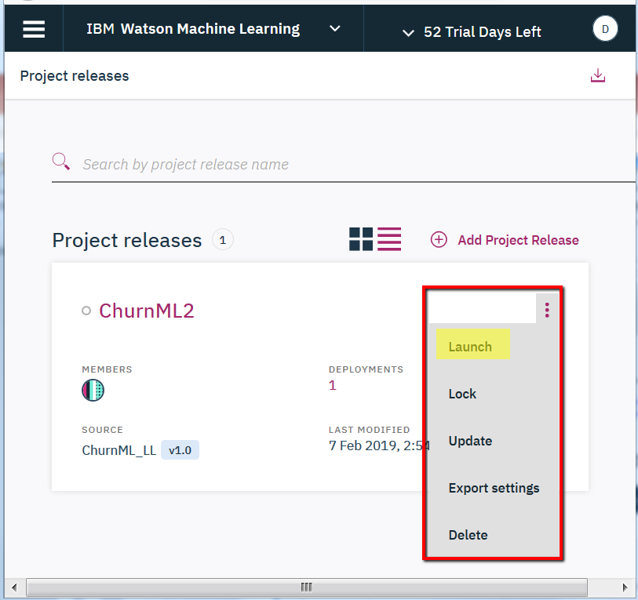
ICP4D/WSL – Lifecycle Overview
Model Management & Deployment
To expose a checkpoint of assets to outside users, a Deployment Admin can create a project release and deploy the assets within it.
A project release represents a project tag that can be launched as a production environment.

Slide 15
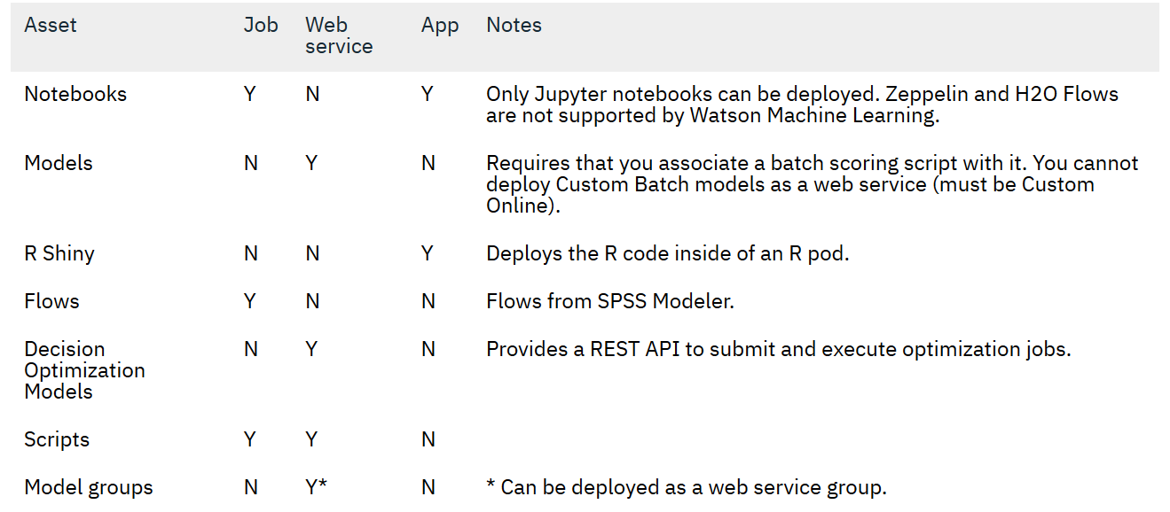
ICP4D/WSL – Lifecycle Overview
5. Model Management & Deployment
An Admin can deploy an asset into a project release
The deployment action creates a read-only snapshot of the asset
The following types of assets can be deployed:

Slide 16
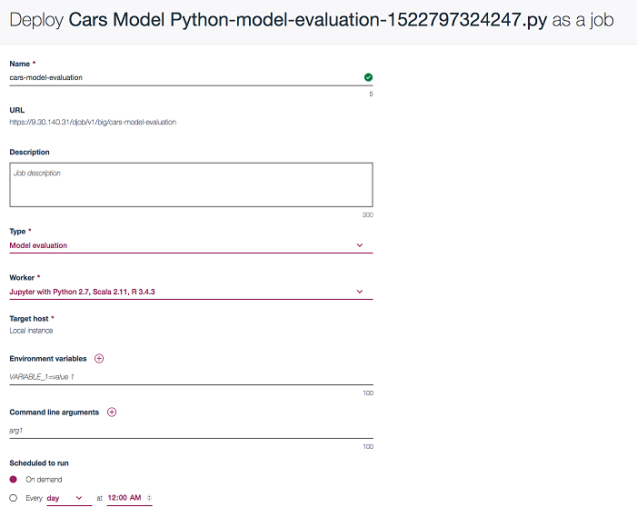
ICP4D/WSL – Lifecycle Overview
6. Run Deployed Job Example
You can navigate to the Assets tab in the Project release details page
When a script is selected in the left panel of the assets table, the right panel of the assets table provides the button to create a job, which brings you to the Create job deployment page.

Slide 17
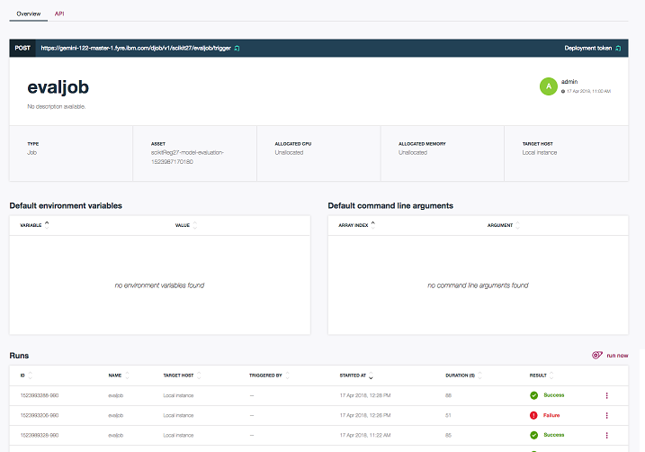
ICP4D/WSL – Lifecycle Overview
6a. Run Deployed Job Example – Overview Tab
A table of environments and arguments for the current job
A table of all the runs for that particular job
A button run now that triggers a job run

Slide 18
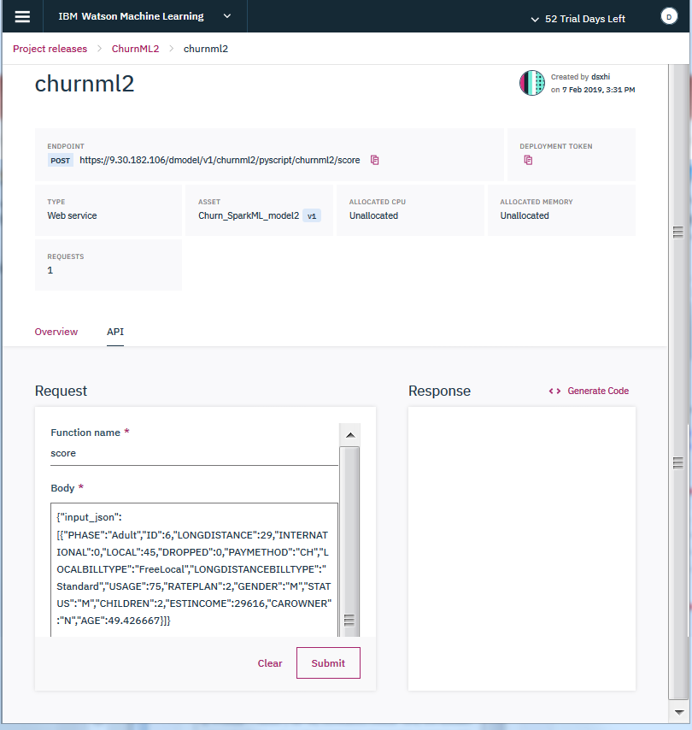
ICP4D/WSL – Lifecycle Overview
6b. Run Deployed Job Example – API Tab
In the API tab, you can enter the function name and testing input, then click on submit

Slide 19
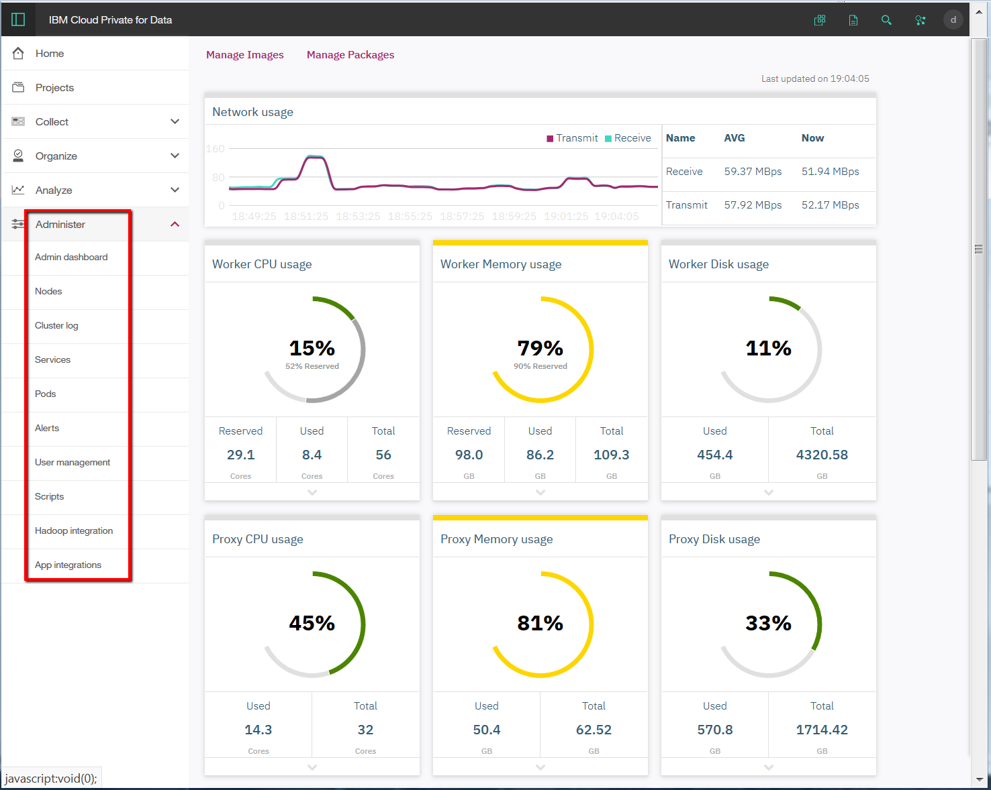
ICP4D/WSL – Lifecycle Overview
Admin Dashboard

Slide 20
IBM Cloud Private for Data / Watson Studio Local Hadoop Integration

Slide 21
Best Practices
Access large amount of data – with Spark and Hadoop
As a best practice, processing should be close to your data. If you need to use large amount of data in HDFS or Hive, It’s best to use the Spark running on Hadoop cluster through Livy.
Take advantage of data localization, and avoids data transfer to speed up your processing.
All runtime environments in WSL & ICP4D (Jupyter, Zeppelin and RStudio) support accessing Hadoop Spark through Livy.

Slide 22
Objective Overview
Hadoop infrastructure is a huge investment but the tools in the ecosystem are not intuitive for business analyst and users. Most of your data is probably available within your HDFS along with your huge compute capacity but access to it is difficult.
Build machine learning and analytics on Watson Studio that provides variety of open source libraries and frameworks such as Spark, R, Keras, TensorFlow, Scikit-learn as a service within a kubernetes based platform behind your firewall. Along with cloud agility the platform provides end-end data management and analytics capability with collaboration and lifecycle management functions.
Hadoop connector provides seamless access to compute power available along with easy access to hdfs data.
Accelerate your machine learning deployments in hours as oppose to months. Build quick to market business decision making Artificial Intelligence systems easily and quickly.

Slide 23
Livy Interface with Spark
Architecture I
YARN Cluster
Executor
Jupyter Server
Livy Server
Remote SparkContext
HTTP Request
Notebook
HTTP Response
RPC
Executor
HTTP Request
Client
HTTP Response

Slide 24


Hadoop Connector Installation & Setup
Architecture II
Internal Network
Edge Node
Hadoop Cluster
DSXHI Gateway
Management Nodes
WebHDFS
50070
Livy
8443
8999
Spark Driver
Hive
HTTPS REST
Worker Nodes
Watson Studio
or ICP4D
8020
Spark Worker
HDFS

Slide 25
Hadoop Gateway Installation & Setup
Installation
Install Livy connector (dsxhi) rpm package
Download connector rpm file from Passport Advantage
Install rpm file (Ex. rpm -ivh dsxhi-icp4data-dsp-1.1.1.0-64.noarch.rpm)
Configure Livy connector
Modify configuration files
# cp /opt/ibm/dsxhi/conf/dsxhi_install.conf.template.HDP /opt/ibm/dsxhi/conf/dsxhi_install.conf
# vi /opt/ibm/dsxhi/conf/dsxhi_install.conf

Slide 26
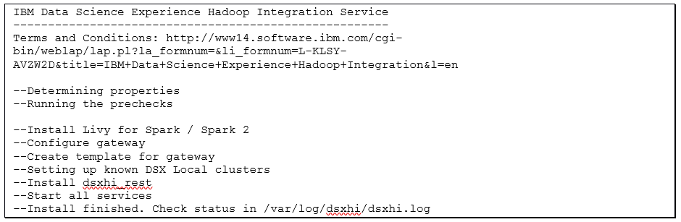
Hadoop Gateway Installation & Setup
Installation
Install Livy connector (dsxhi)
Install connector
# /opt/ibm/dsxhi/bin/install.py --dsxhi_gateway_master_password=<password> --password=<password>

Slide 27
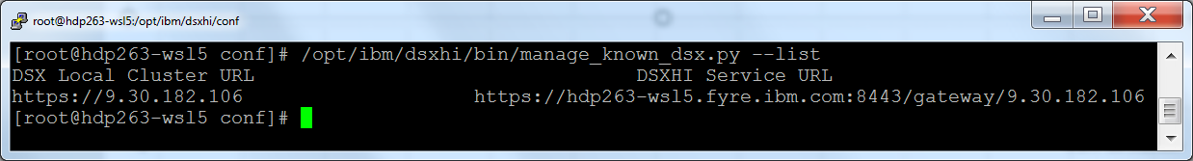
Hadoop Gateway Installation & Setup
Verify Installation
Livy connector process status check
/opt/ibm/dsxhi/bin/status.py
List registered WSL cluster(s)
/opt/ibm/dsxhi/bin/manage_known_dsx.py –list
Register/Add new WSL cluster
/opt/ibm/dsxhi/bin/manage_known_dsx.py --add https://<WSL_FQDN>

Slide 28
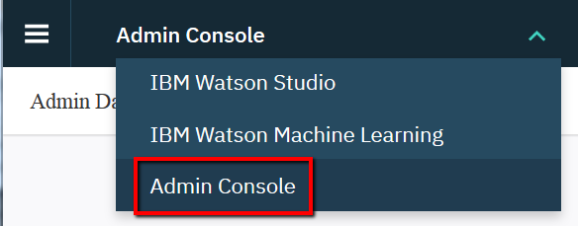

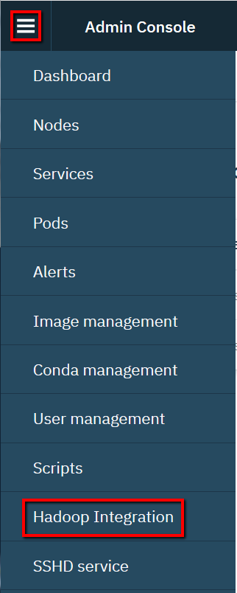
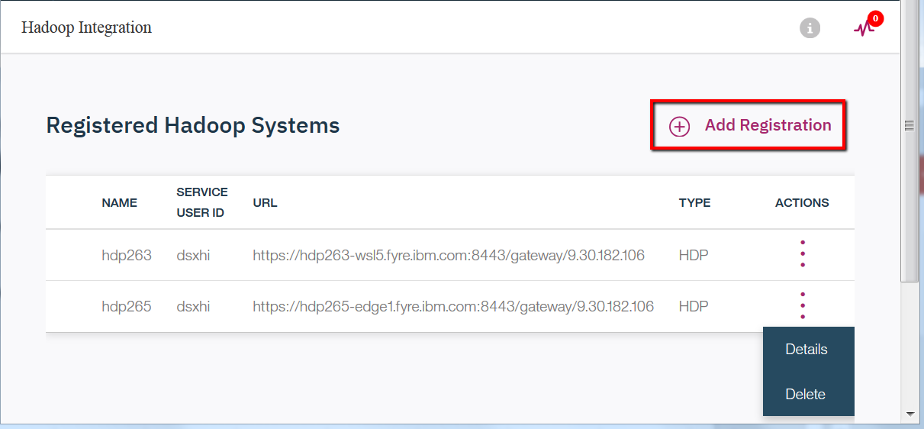
Hadoop Gateway Installation & Setup
Register Hadoop System in WSL Admin Console
Select “Admin Console” from Top drop down
In the Admin Console, click the menu icon ( ) and click Hadoop Integration to view current registered Hadoop Cluster and/or register new Hadoop Clusters

Slide 29
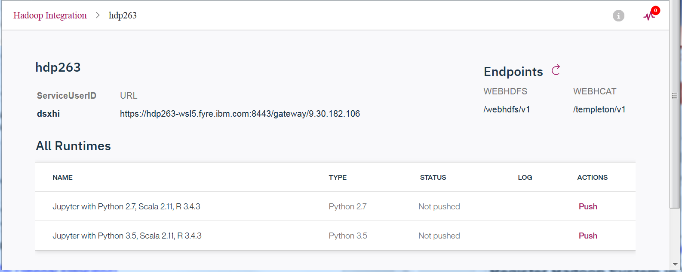
Hadoop Gateway Installation & Setup
Register Hadoop System in WSL Admin Console
When you click on the icon ( ) under “Actions”, you can see the details on service endpoints.
In the Admin Console, click the menu icon ( ) and click Hadoop Integration to view current registered Hadoop Cluster and/or register new Hadoop Clusters

Slide 30
Hadoop Gateway Testing and Troubleshoot
Retrieve data from HDFS file system
Access to Hive database table data
Push down Spark job/task to the remote Spark2 server on Hadoop cluster

Slide 31
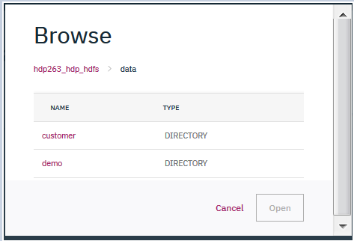
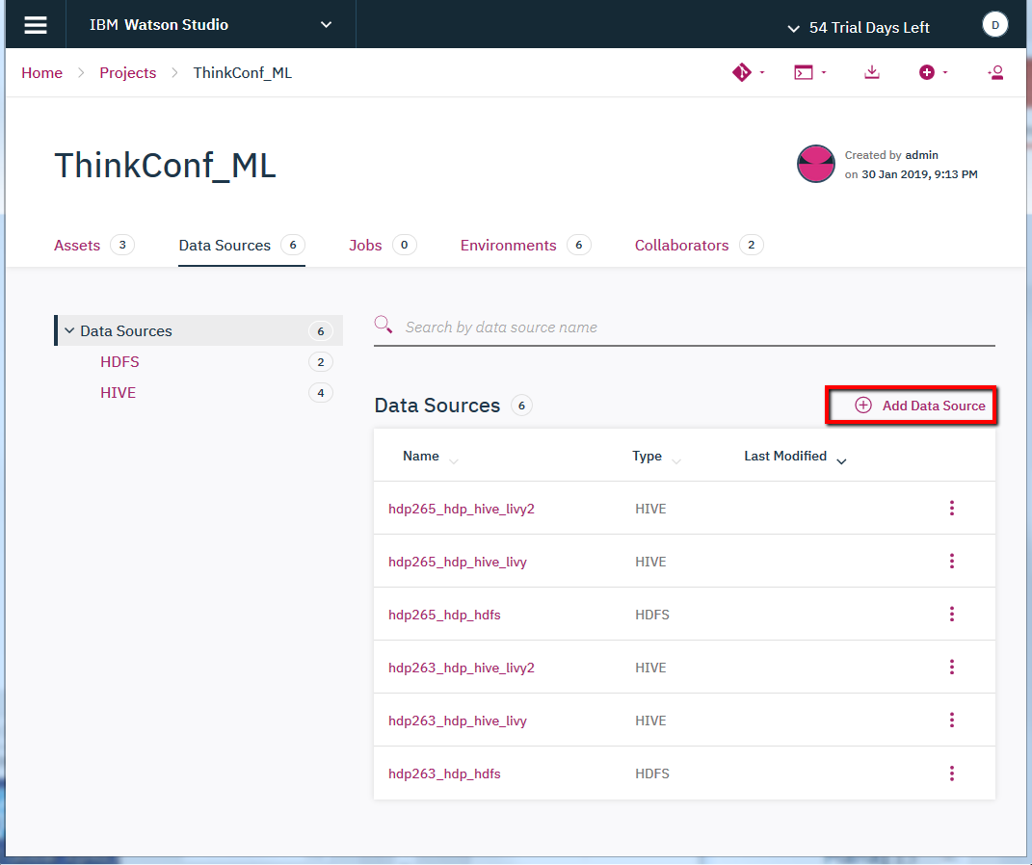
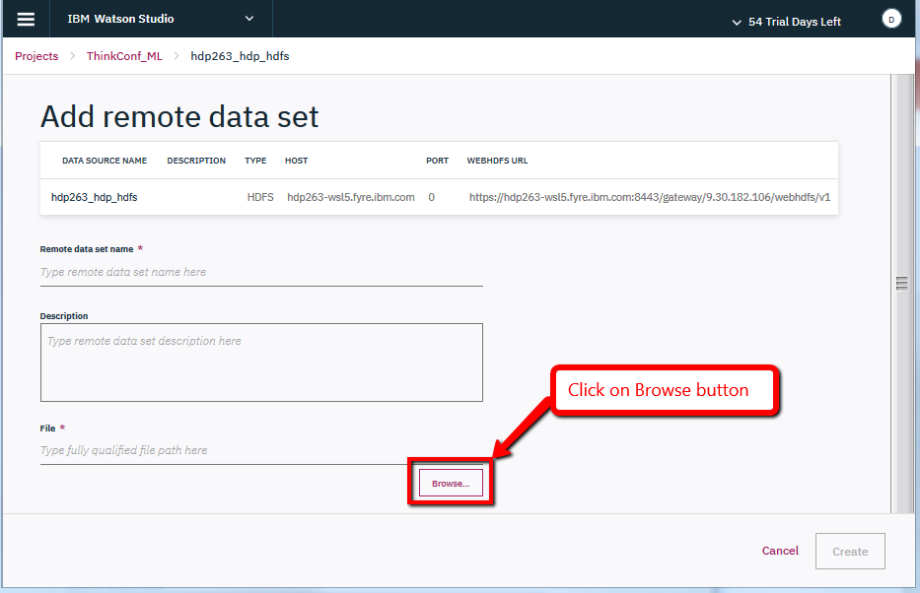
Hadoop Gateway Testing and Troubleshoot
1. Retrieving data from HDFS file system
Add a remote data source from project dashboard

Slide 32
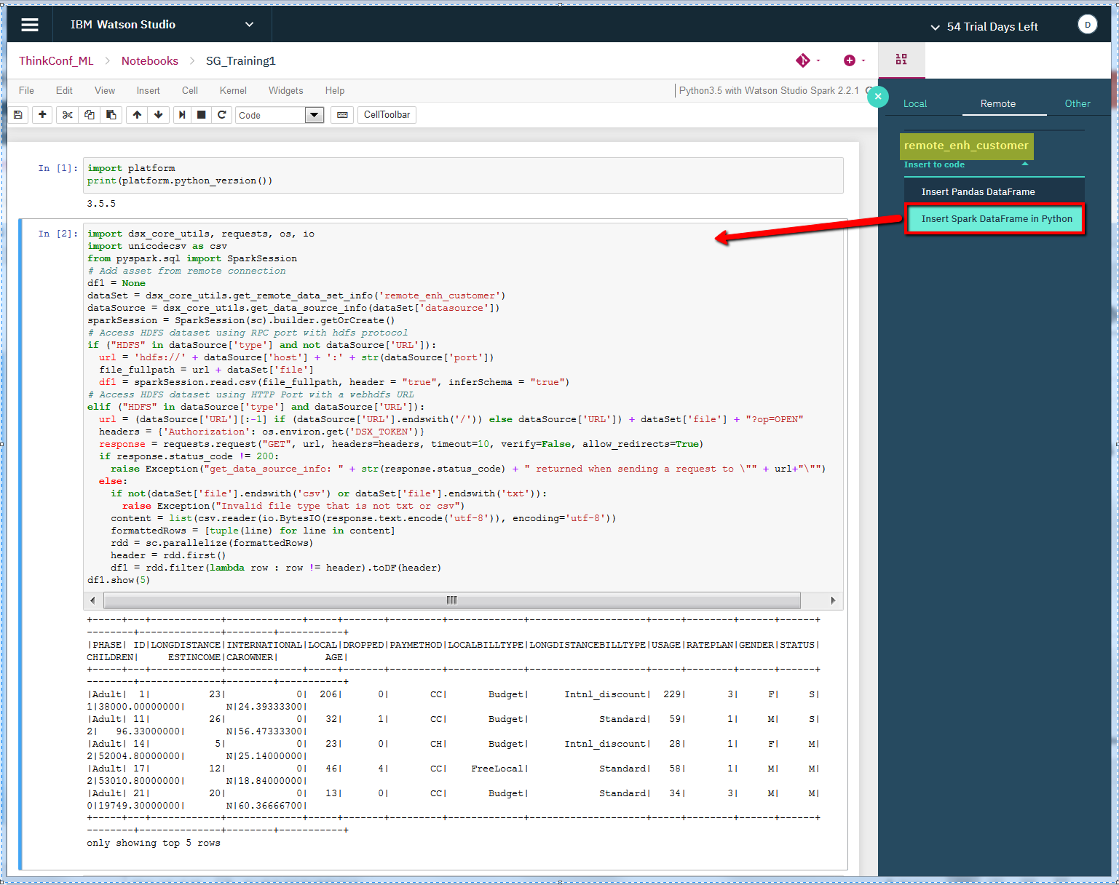
Hadoop Gateway Testing and Troubleshoot
2. Use added remote HDFS data source in Notebooks
Click on icon ( ) and select the Remote data source created from previous instruction; then select “Insert Spark DataFrame in Python”.

Slide 33
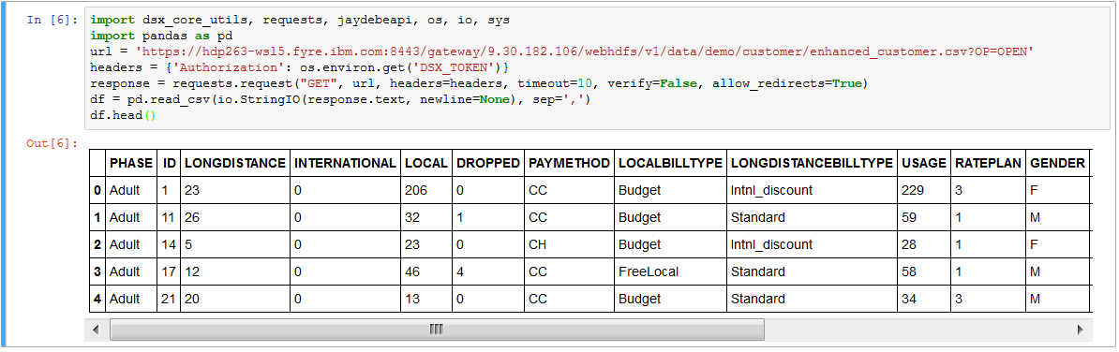
Hadoop Gateway Testing and Troubleshoot
3. Load HDFS dataset via remote Spark session
Example code:
import dsx_core_utils, requests, jaydebeapi, os, io, sys
import pandas as pd
url = 'https://hdp263-wsl5.fyre.ibm.com:8443/gateway/9.30.182.106/webhdfs/v1/data/demo/customer/enhanced_customer.csv?OP=OPEN'
headers = {'Authorization': os.environ.get('DSX_TOKEN')}
response = requests.request("GET", url, headers=headers, timeout=10, verify=False, allow_redirects=True)
df = pd.read_csv(io.StringIO(response.text, newline=None), sep=',')
df.head()

Slide 34
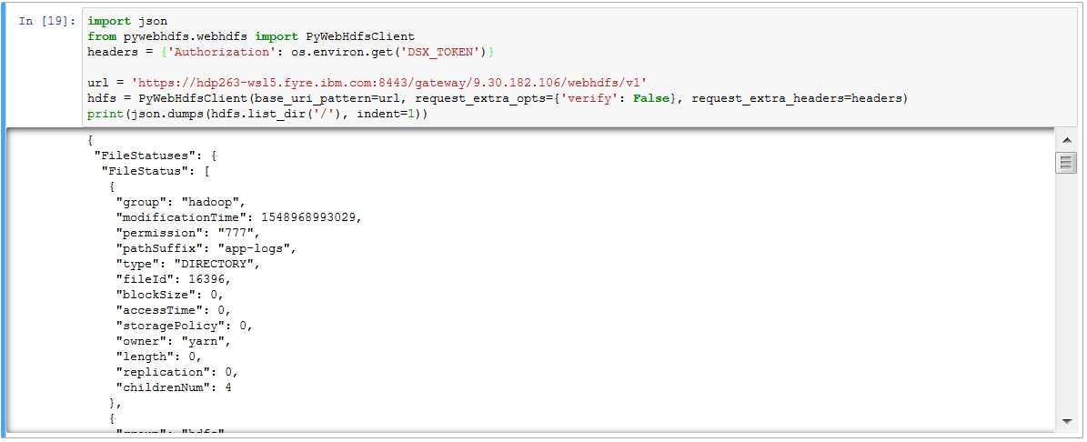
Hadoop Gateway Testing and Troubleshoot
4. Load HDFS dataset via “PyWebHdfs” package
import json
from pywebhdfs.webhdfs import PyWebHdfsClient
headers = {'Authorization': os.environ.get('DSX_TOKEN')}
url = 'https://hdp263-wsl5.fyre.ibm.com:8443/gateway/9.30.182.106/webhdfs/v1'
hdfs = PyWebHdfsClient(base_uri_pattern=url, request_extra_opts={'verify': False}, request_extra_headers=headers)
print(json.dumps(hdfs.list_dir('/'), indent=1))

Slide 35
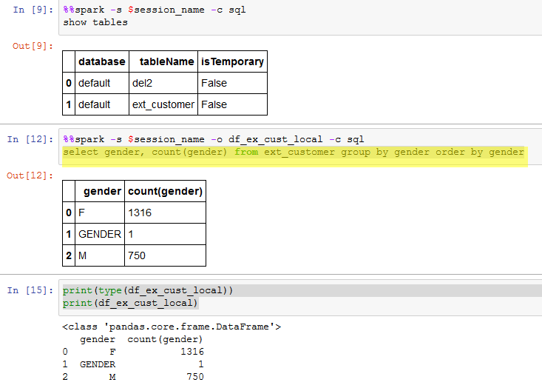
Hadoop Gateway Testing and Troubleshoot
5. Access Hive data
%%spark -s <session_name> -c sql -o <local_dataframe>
select gender, count(gender) from ext_customer group by gender order by gender
print(type(df_ex_cust_local))
print(df_ex_cust_local)

Slide 36
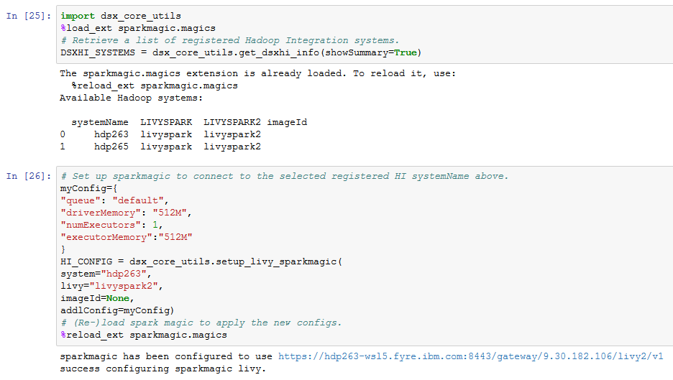
Hadoop Gateway Testing and Troubleshoot
6. Push down Spark processing

Slide 37
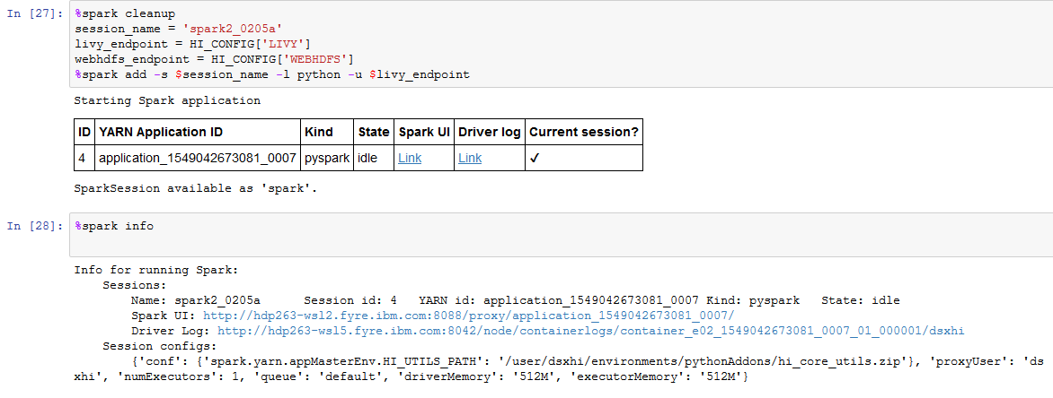
Hadoop Gateway Testing and Troubleshoot
6. Push down Spark processing

Slide 38
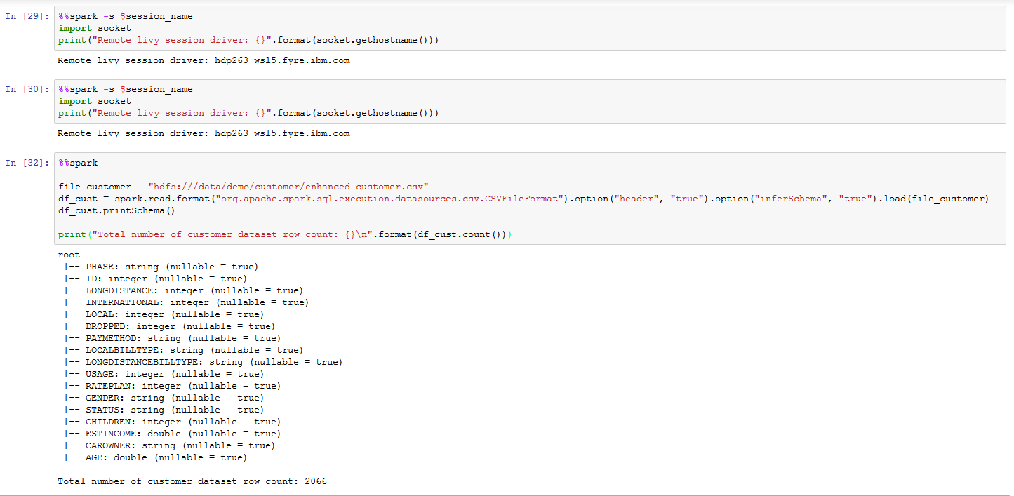
Hadoop Gateway Testing and Troubleshoot
6. Push down Spark processing

Slide 39
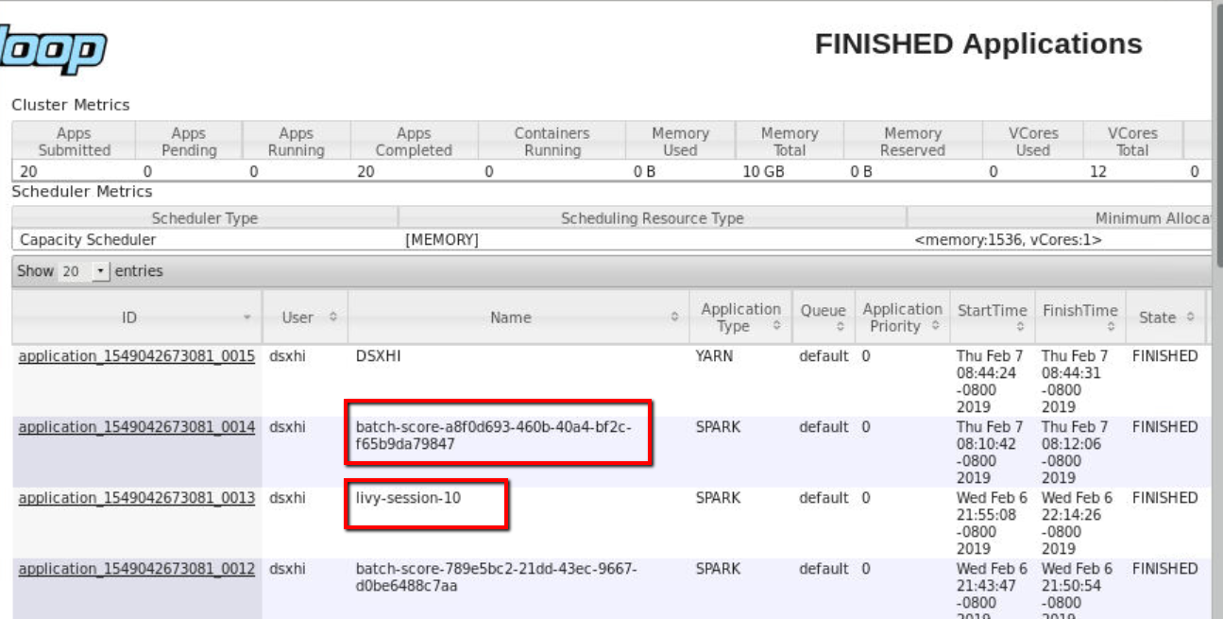
Hadoop Gateway Testing and Troubleshoot
6. Push down Spark processing – Review the remote Spark application

Slide 40
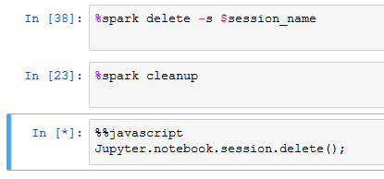
Hadoop Gateway Testing and Troubleshoot
Delete the remote Spark session**
%spark delete -s <session_name>

Slide 41
For additional learning
Kubernetes - https://kubernetes.io/docs/concepts/
Dockers and containers - https://docs.docker.com/engine/docker-overview/
IBM Cloud Private documentation : https://www.ibm.com/support/knowledgecenter/en/SSBS6K_2.1.0.3/getting_started/introduction.html
IBM Cloud Private for Data documentation : https://docs-icpdata.mybluemix.net/docs/content/com.ibm.icpdata.doc/zen/overview/overview.html

Slide 42
Backup Slides

